Slide 1
INVOICE ASSISTANT
Presented by :- Viraj Tank Faculty Supervisor :- Dr. NarendraKumar Chauhan External Guide :- Mr. Umesh Ghediya

Slide 2
Agenda
INTRODUCTION 3
FLOWCHART 4
WORKFLOW 5
PROJECT DEMONSTRATION 15
RESULT & OBSERVATIONS 16
CONCLUSION 17

Slide 3
INTRODUCTION
In today's digital world, managing invoices manually can be time-consuming and error-prone. The Invoice Assistant is designed to automate the extraction and analysis of invoice data using artificial intelligence. This project integrates a Telegram bot that allows users to upload invoices in PDF or image format, which are then processed using Google Gemini to extract key details such as supplier information, invoice numbers, itemized lists, and payment details.
The extracted data is structured into a JSON format, making it easy to store, analyze, and retrieve information. Additionally, users can interactively query the bot about specific invoice details, enhancing accessibility and usability.

Slide 4
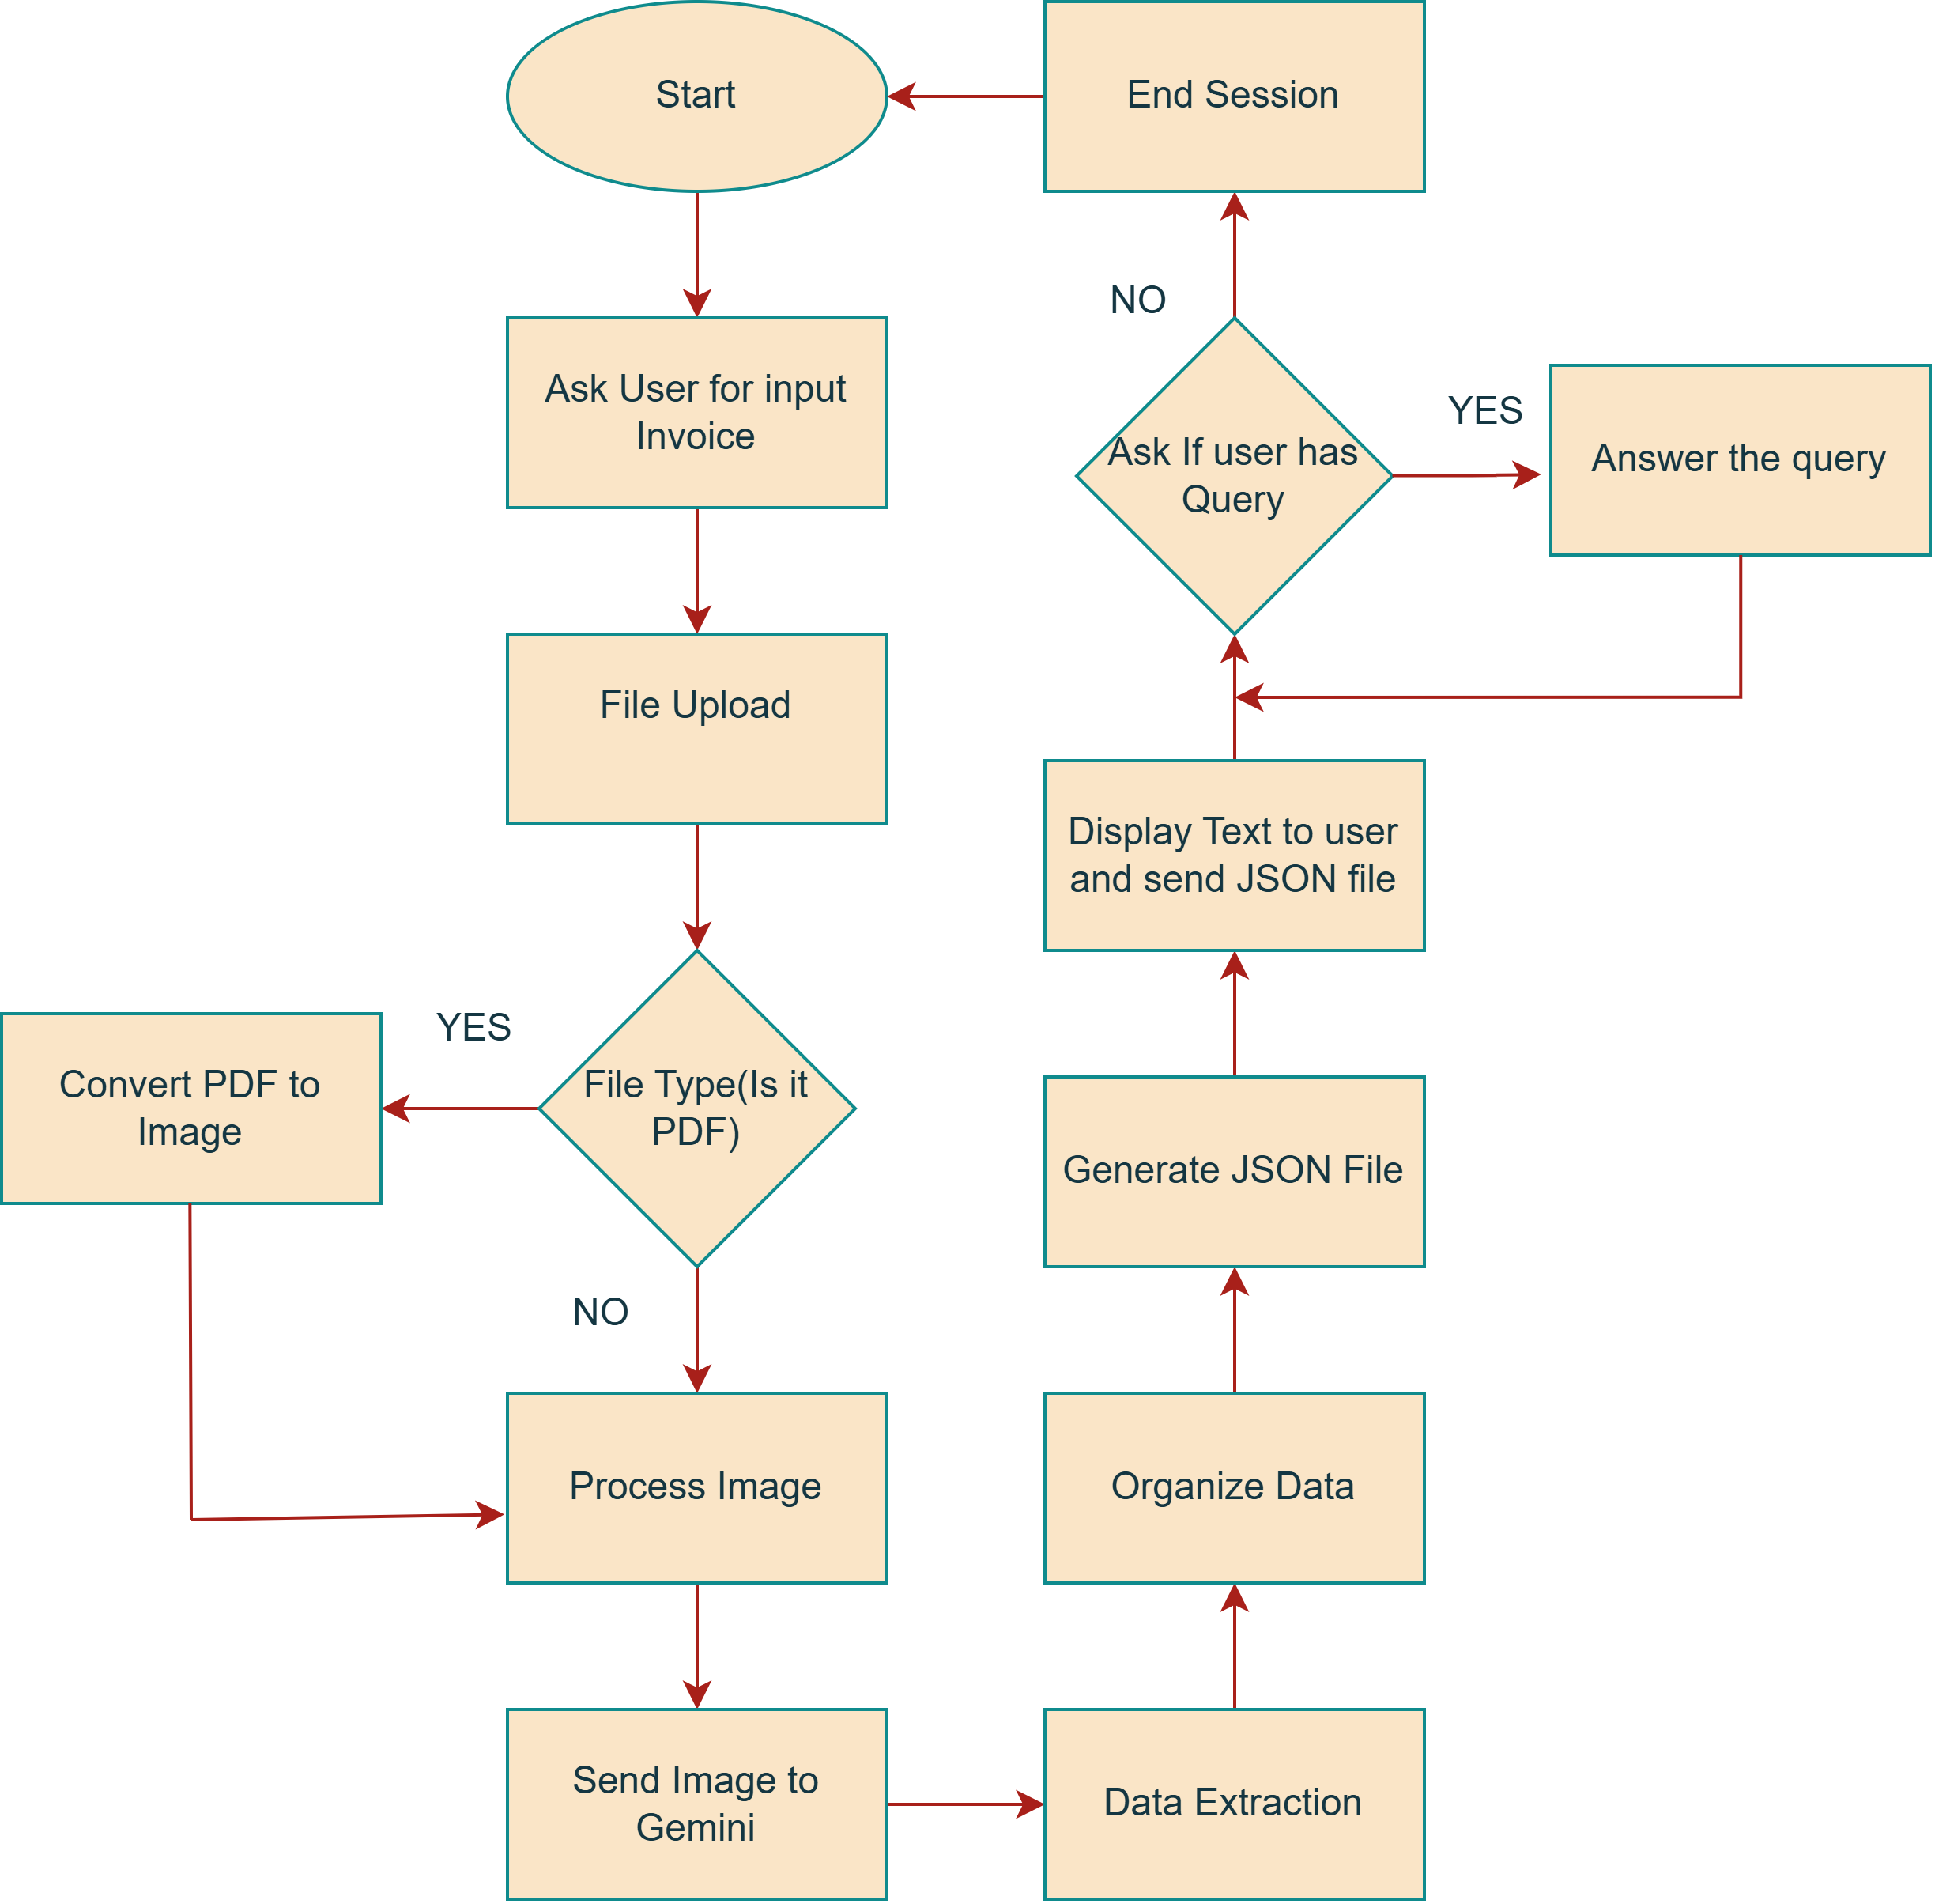
Flowchart

Slide 5
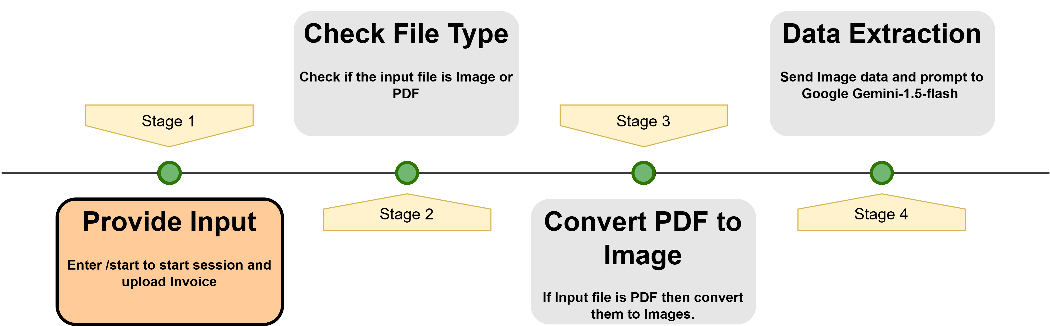
The start function responds to the /start command by greeting the user and instructing them to upload an invoice file. It runs asynchronously to ensure smooth interaction without delays.
WORKFLOW

Slide 6
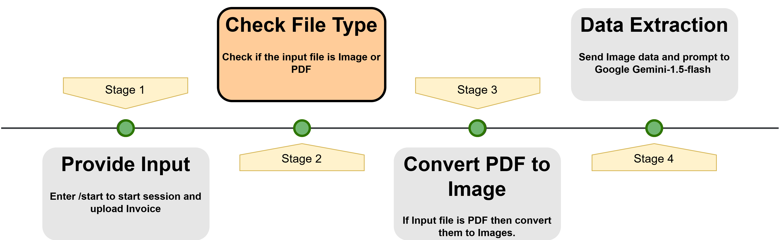
Then it manages file uploads from users while handling connection errors. It first checks if the uploaded file is a supported format (PDF or image).

Slide 7
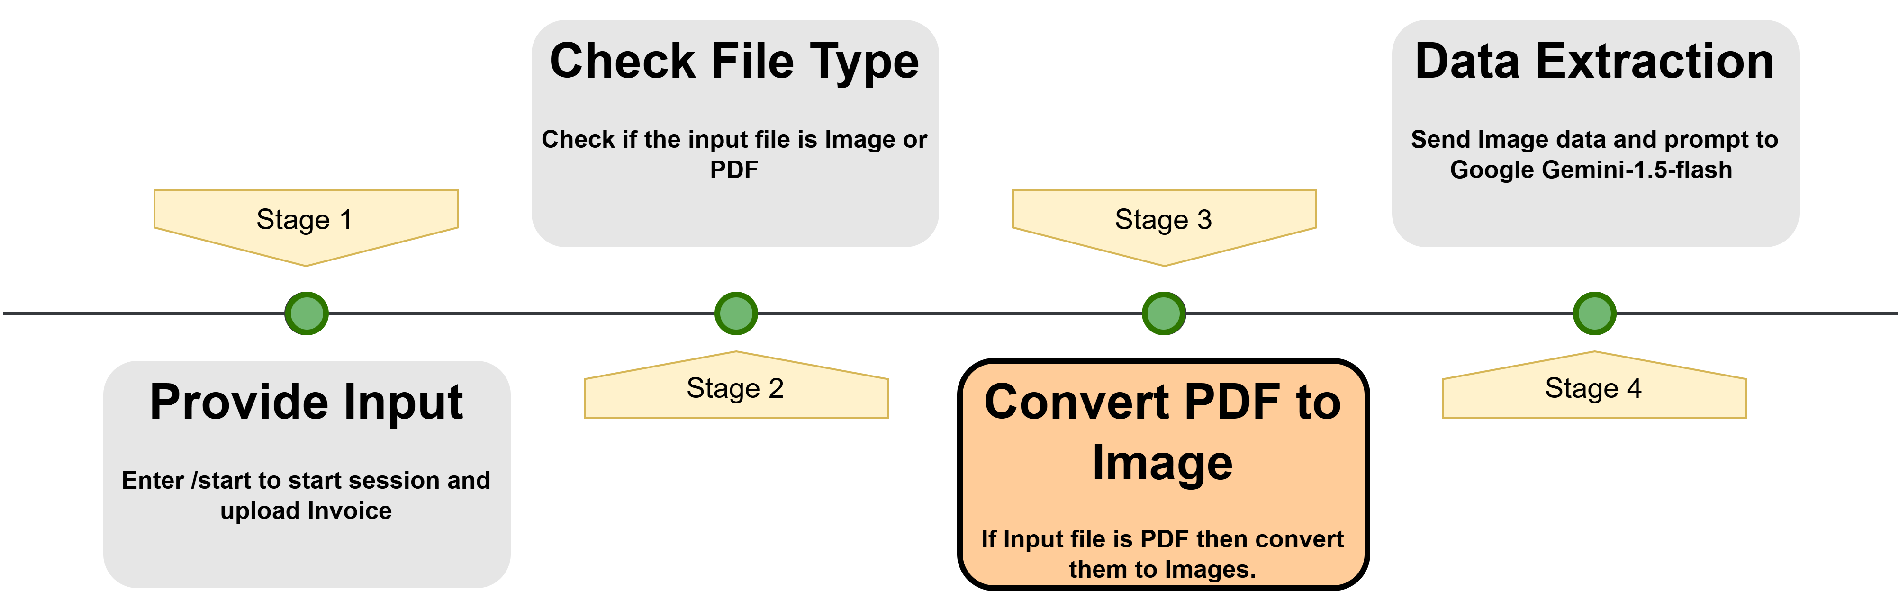
If the file is a PDF, it is converted into an image for further processing. Then it creates a user specific directory and downloads the file.

Slide 8
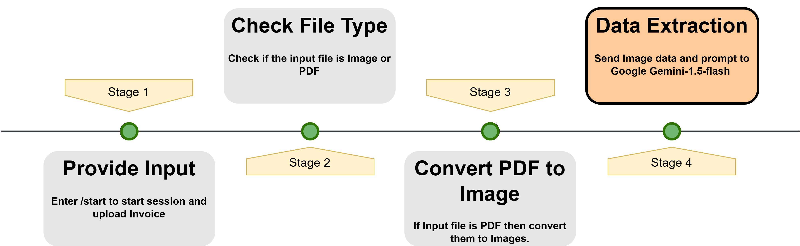
For next step now it sends the invoice image to Google Gemini for text extraction and processes the extracted data.

Slide 9
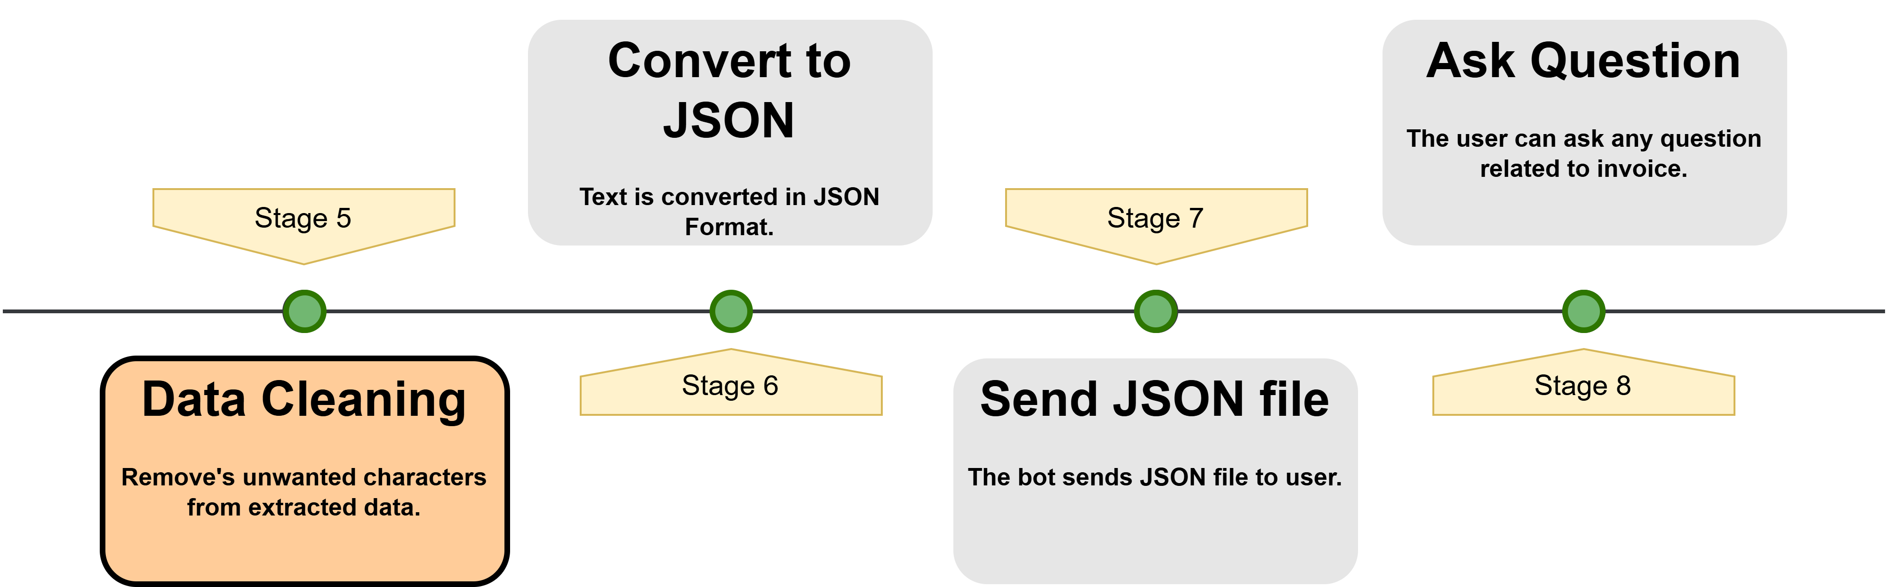
The extracted text is cleaned. That is it removes extra characters with might hinder us while converting it to JSON file.

Slide 10
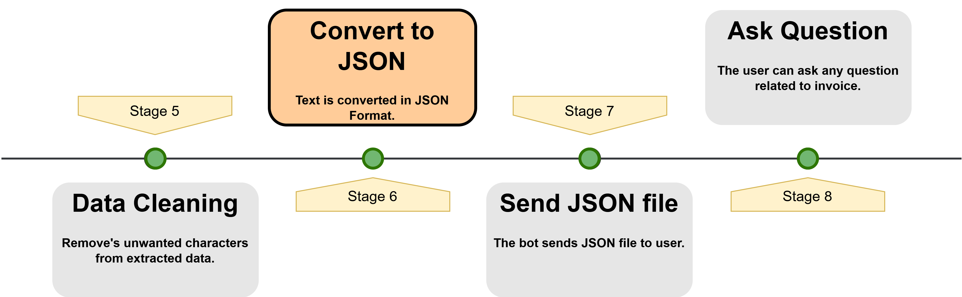
The extracted text is cleaned and converted into JSON format. If valid, the data is saved as a JSON file.

Slide 11
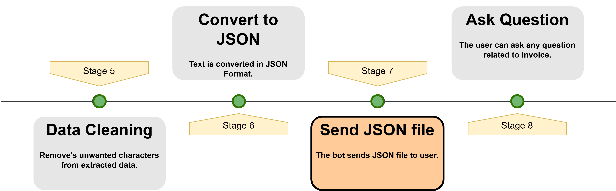
The data is saved as a JSON file in the user’s directory and sent to the user. If the response is not valid JSON, the raw text is shared instead.

Slide 12
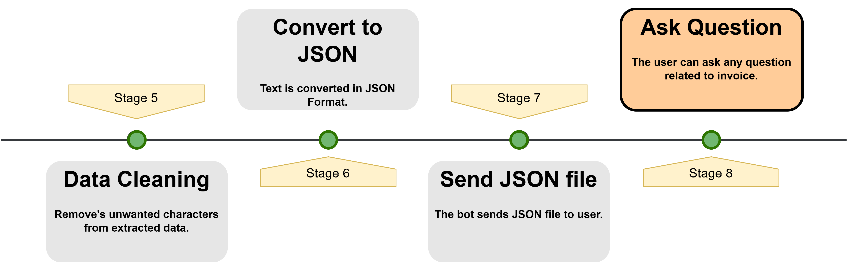
Now in next step it allows users to ask questions about their uploaded invoice. It first checks if the user has uploaded an invoice; if not, it prompts them to do so.

Slide 13
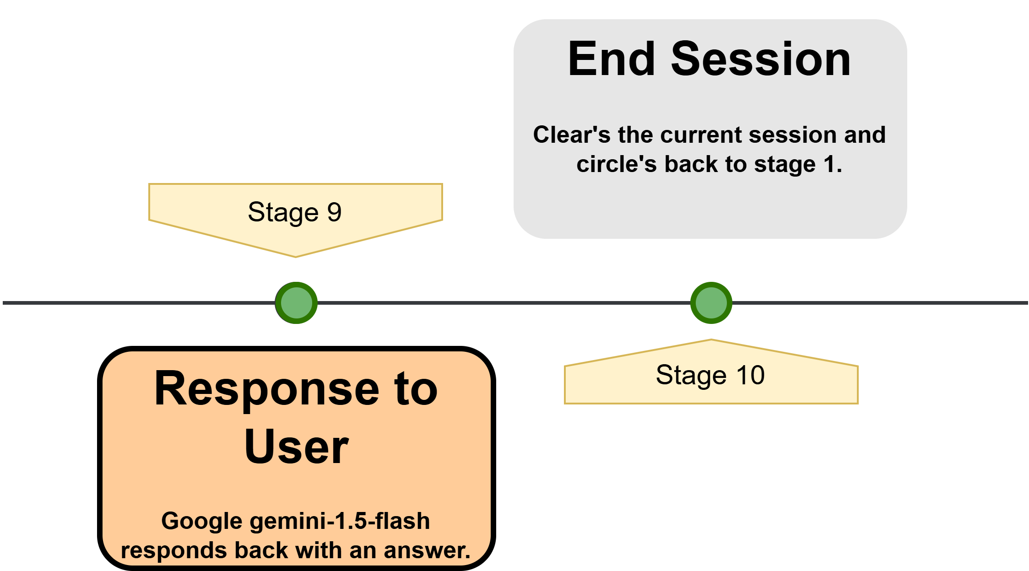
The user’s question is formatted into a structured prompt for Google Gemini, which extracts relevant details from the invoice and responds back to user with an answer.

Slide 14
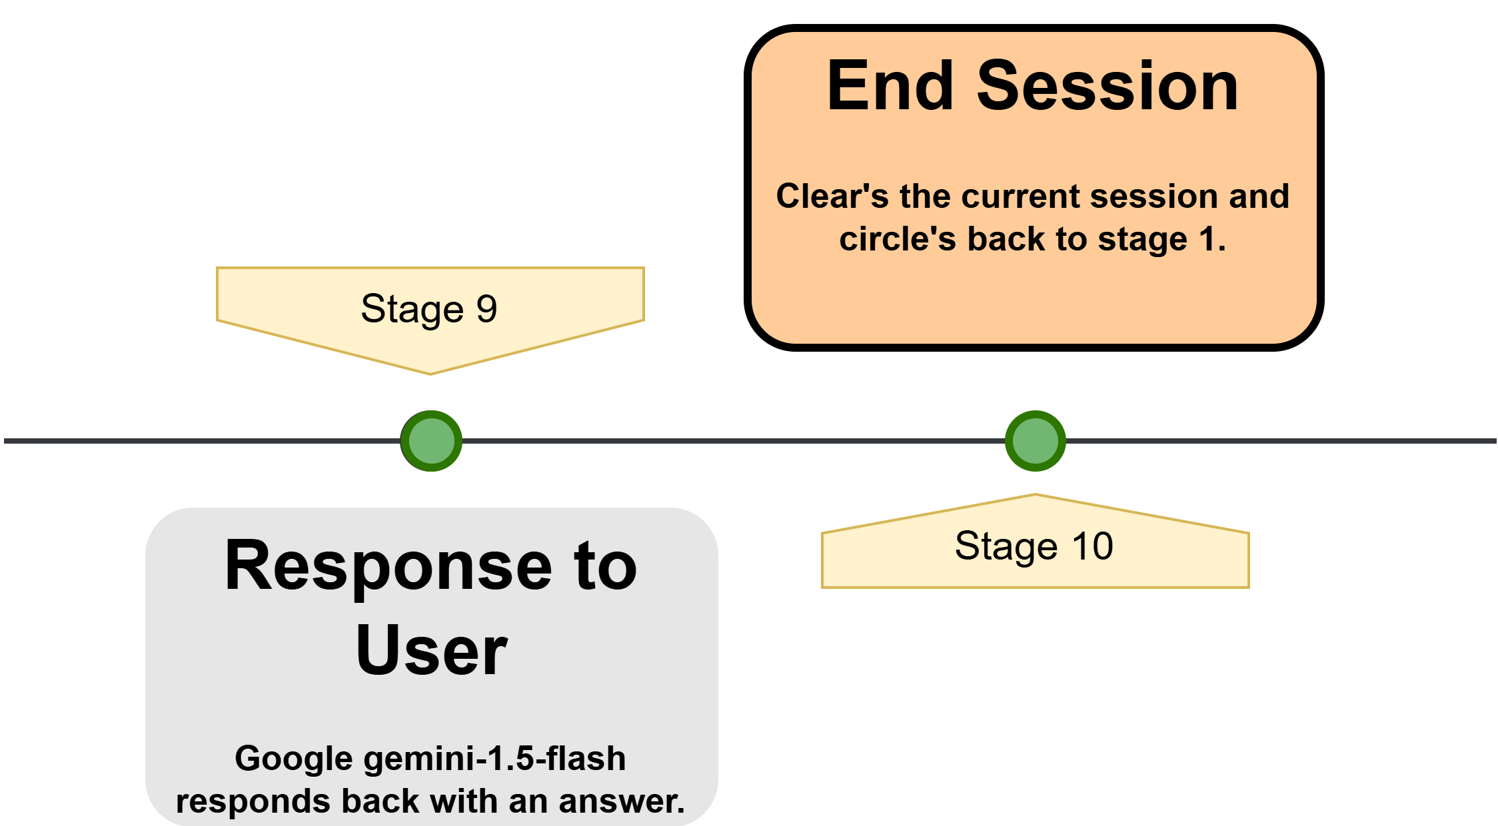
Lastly it clears the user’s session by removing their data, ensuring a fresh start for the next interaction. It then sends a message confirming that the session has ended and instructs the user to restart with the /start command if they want to process another invoice.

Slide 15
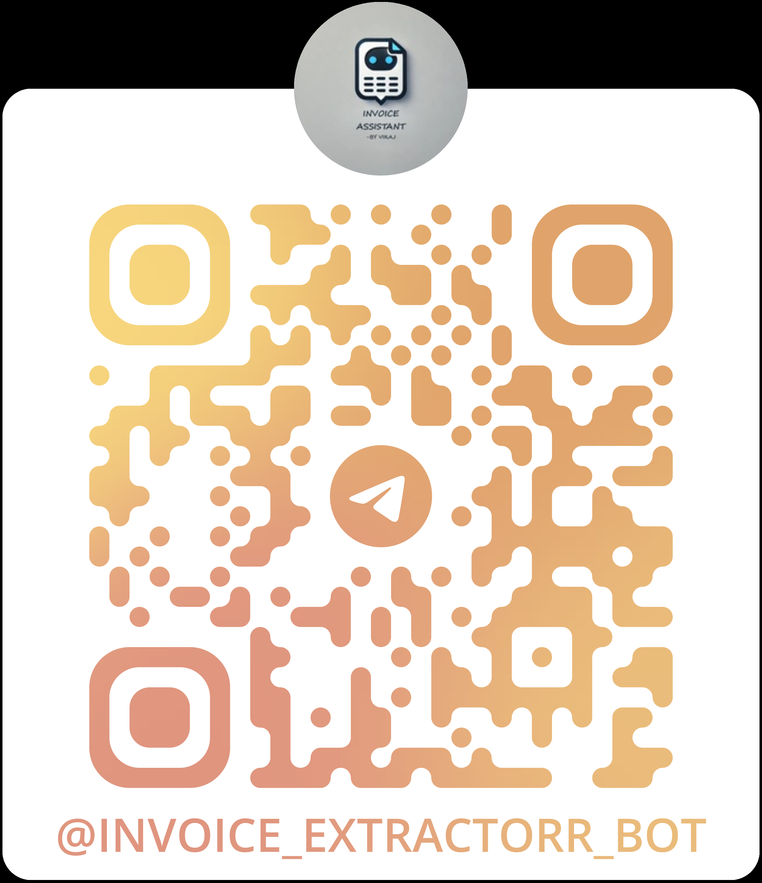
Project Demonstration
How to Use the Invoice Assistant :-
Scan the QR Code to access the Telegram bot.
Start the bot by clicking Start or using the /start command.
Upload an invoice in PDF or image format (JPG, PNG, JPEG).
The bot processes the invoice, extracts key details, and organizes them into JSON format.
The extracted details are sent back to the user, and a JSON file is generated.
The user can ask specific questions about the invoice using /ask <question>.
Once done, the user can end the session with /end, clearing the current data.

Slide 16
Result & Observation’s
The bot successfully extracts and organizes invoice details into a structured JSON format.
Google Gemini provides accurate results, even for different invoice layouts.
When providing multiple invoices at a time it extracts data from all invoices but answers only to the last invoice uploaded.
Sometimes when there is connection issue we have retry mechanism which ensures smooth operation.
Logging helps in debugging issues and tracking user interactions efficiently.
Some invoices with unclear text or poor image quality may result in incomplete or inaccurate extraction.
In this we can still optimise the input prompts for further accuracy for complex layouts.

Slide 17
Conclusion
The Invoice Assistant automates invoice data extraction from PDFs and images.
Google Gemini processes various invoice formats and provides accurate responses.
Retry mechanisms and logging ensure smooth operation, even during network issues.
The bot runs only while the code is active in VS Code; it stops if the script is terminated.
For continuous deployment, platforms like AWS, Google Cloud, or Microsoft Azure can be used.
Extraction accuracy depends on image quality; blurry or low-resolution invoices may cause errors.
The free tier of Google Gemini has request limits, which may slow down processing for multiple page invoices.
Struggles with handwritten invoices or non-standard layouts, requiring better OCR solutions.
Despite limitations, it streamlines invoice management, reduces manual work, and improves efficiency.

Slide 18
Any Questions ?

Slide 19
Thank You for Your Time!

